Slide 1

WORK SURVEY
Remote work survey
INSTITUTE OF EMERGING CAREERS
Learn Earn Contribute
REMOTE
BY: FAZAL HANAN

Slide 2
PROBLEM STATEMENT:
REMOTE WORK SURVEY
COVID-19 made a lot of people work from home. This study wants to understand how this change has affected people's work lives. We're interested in how people feel about their productivity, the challenges they face when working online, and if their opinions about working from home have shifted because of the pandemic. By figuring out these things, we hope to help companies make remote work better for everyone.

Slide 3
data Overview:
Survey results of 1,500 remote workers from the Australian state of New South Wales, taken in August-September 2020, which aimed to capture the shift in remote work experiences and attitudes during different stages of the COVID-19 pandemic and gain insights on its long term implications.

Slide 4
OBJECTIVES
MENU
ANALYSIS
CONTACT
Provide a concise overview of the entire report, summarizing the main findings.
Highlight the most important insights and key data points discovered during the analysis.
Clearly present actionable recommendations derived from the analysis.
Emphasizing how the insights can guide strategic decisions.

Slide 5
DATA ANALYSIS PROCESS
2
Remote work survey
Understanding Key Problems and Define Objectives.
Data Preparation and Cleaning.
Data Processing and Analysis.
Visualization, generating insights and Recommendations.

Slide 6
Questions:
REMOTE WORK SURVEY
What can be expected post-pandemic?
Does working remotely positively impact productivity?
Are there any other benefits?
How does an employees use of time differ when working remotely vs on-site?
What are the biggest barriers to overcome if remote work becomes the norm in the future?

Slide 7
DATA ANALYSIS & VISUALIZATION
MENU
ANALYSIS
CONTACT
Data ANALYSIS

Slide 8
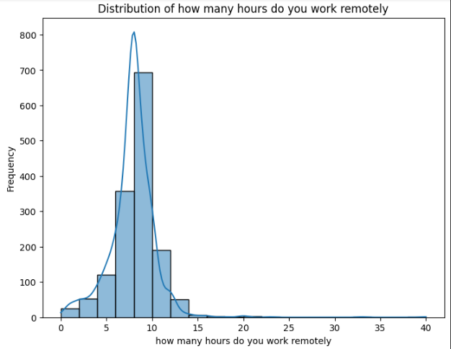
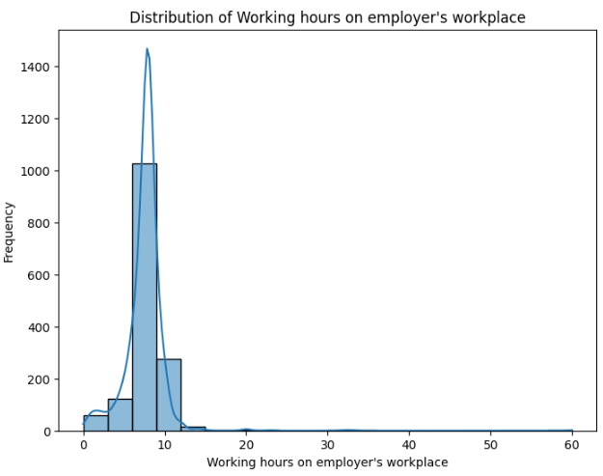
Working Hours
Remote work
Employere’s Workplace
Data ANALYSIS

Slide 9
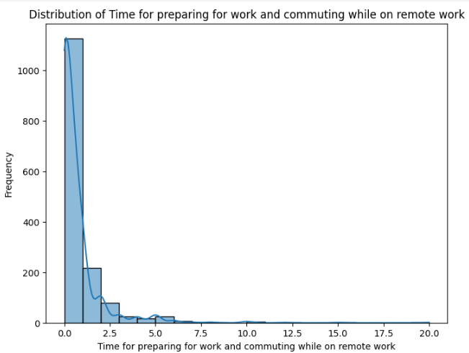
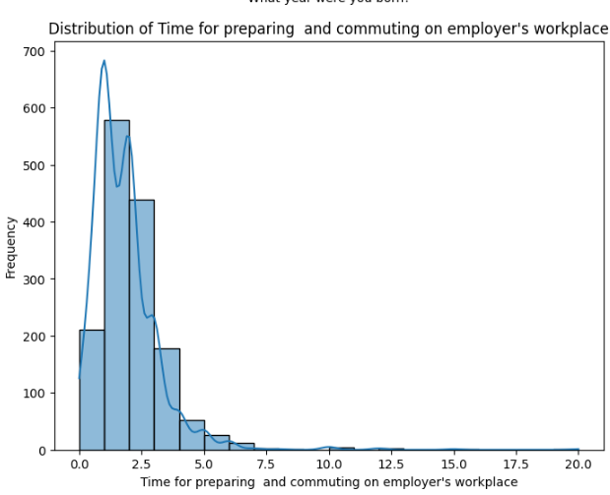
Time for preparing and commuting
Remote work
Employere’s Workplace
Data ANALYSIS

Slide 10
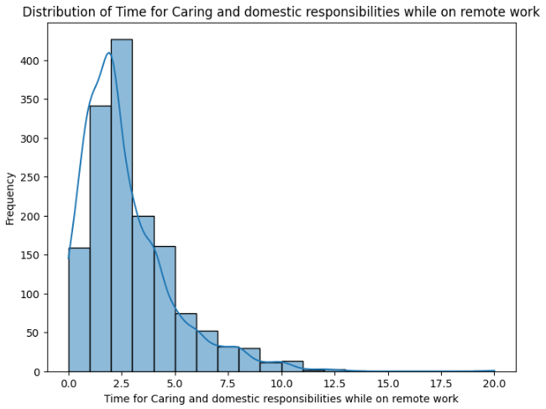
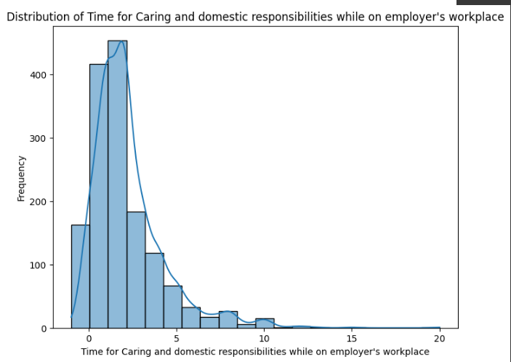
Time for Caring and Domestic responsibilities
Remote work
Employere’s Workplace
Data ANALYSIS

Slide 11
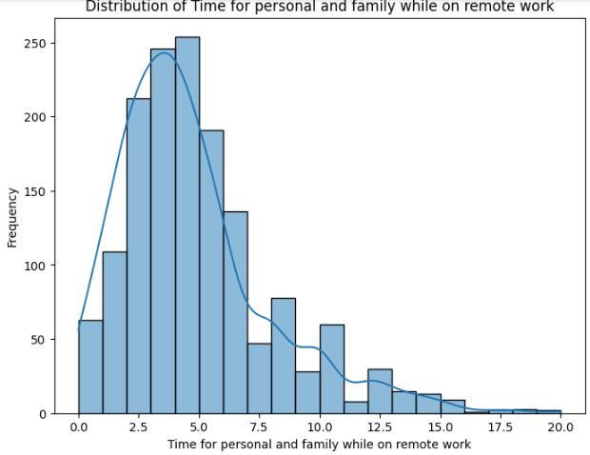
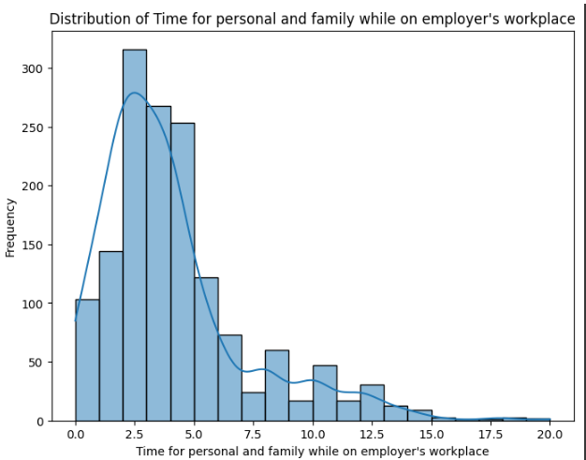
Personal and Family Time
Remote work
Employere’s Workplace
Data ANALYSIS

Slide 12
THIS IS A TABLE
MENU
ANALYSIS
CONTACT
Data ANALYSIS
 | Remote work | Employer’s workplace
Working Hours | 9 to 10 hours | 9 to 10 hours
Time for preparing and commuting | 01 hour | 02 hours
Time for Caring and Domestic responsibilities | 2.5 hours | 03 hours
Personal and Family Time | 5 to 6 hours | 3 to 4 hours

Slide 13
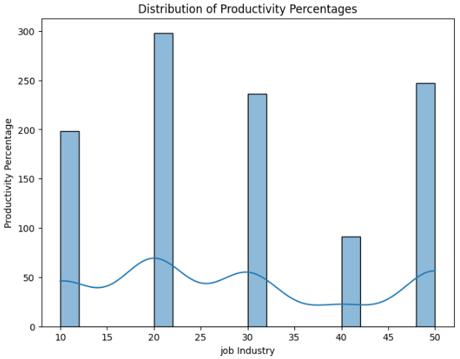
PRODUCTIVITY
The productivity rate is about 28% and result is AS shown
Data ANALYSIS

Slide 14
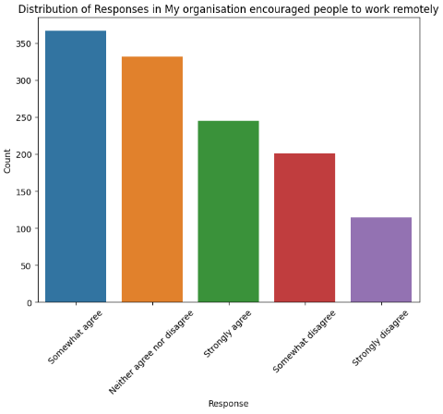
Encouragement towards remote working.
Data ANALYSIS
Overall encouragment response is about 700 which below the half of total

Slide 15
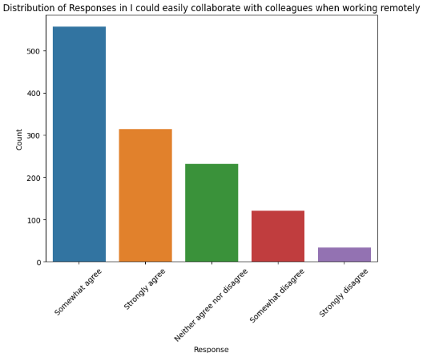
Collaboration with Colleagues
Data ANALYSIS
Overall agree rate is above than 800 which high rate comparetively.

Slide 16
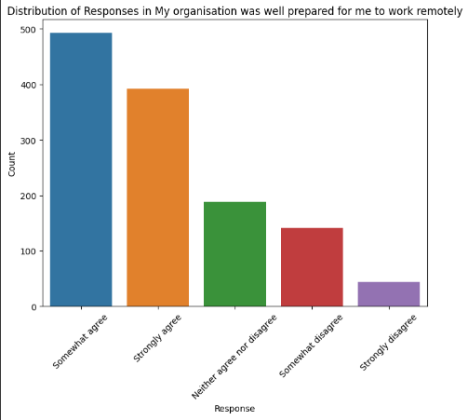
PREPARING FOR REMOTE WORK
Data ANALYSIS
Overall Agree response is about 500 which below the half of total

Slide 17
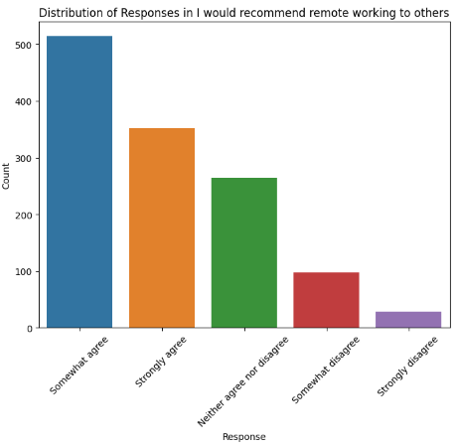
RECOMMEND REMOTE WORK TO OTHERS
Data ANALYSIS
Overall Agree response is about 500 which is also below the half of total.

Slide 18
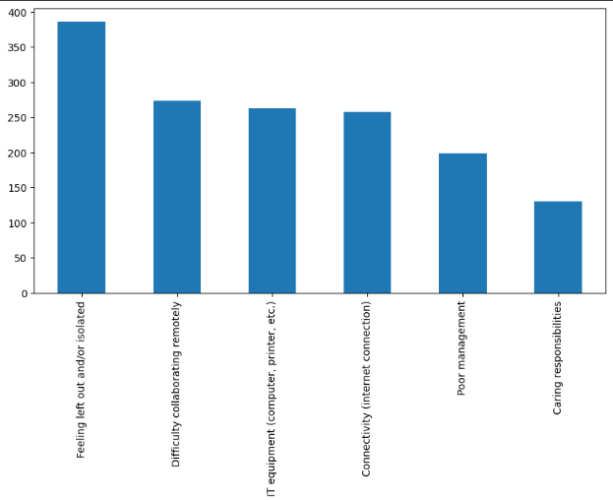
BARRIERs IN REMOTE WORKING
MENU
ANALYSIS
CONTACT
Data ANALYSIS
Feeling left out or Isolated
About 1200 respondents were from metro region

Slide 19
RECOMMENDATIONS
MENU
ANALYSIS
CONTACT
Data ANALYSIS
Flexible Remote Work Policies.
Technology and Infrastructure Investments.
Training and Skill Development.
Employee Wellbeing Initiatives.
Continuous Communication and Feedback.
Workspace Support.
Task Accessibility and Adaptability.

Slide 20

Thanks!
Data ANALYSIS
Remote working survey
Dataset: maven analytics
Tools used: Python, power BI
By: Fazal Hannan

